Slide 1
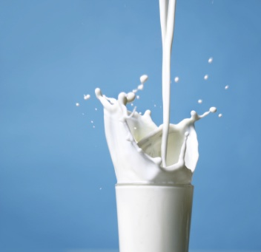
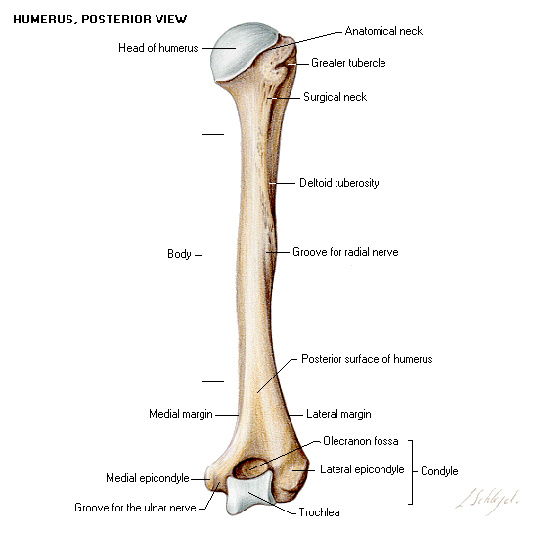
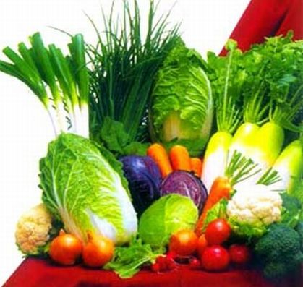
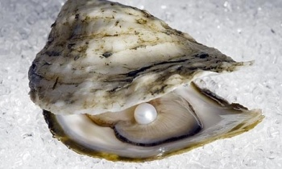
CALCAREA CARBONICA
Dr. C.R. KRISHNA KUMARI AMMA
HOD & PROF
Dept Of Materia Medica

Slide 2
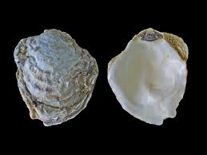
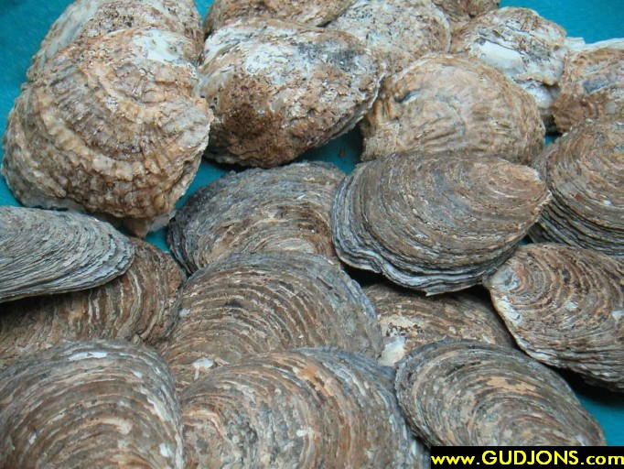
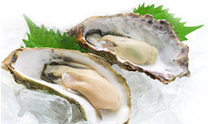
COMMON NAME
CALCAREA OSTREARUM
Middle Layer of Oyster shell.
Calcium carbonate(CaCO3)

Slide 3
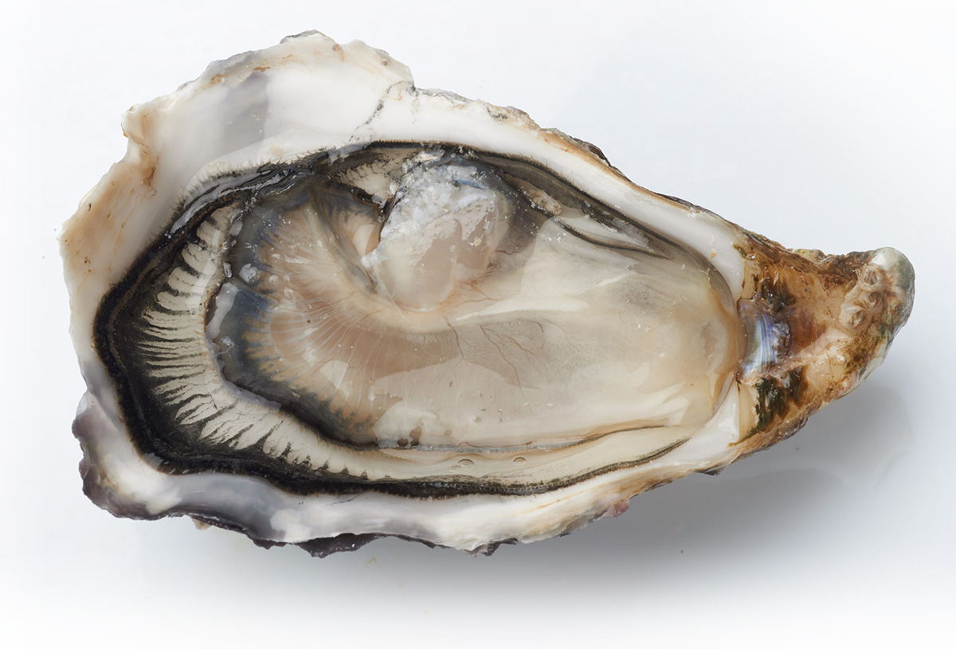

Slide 4
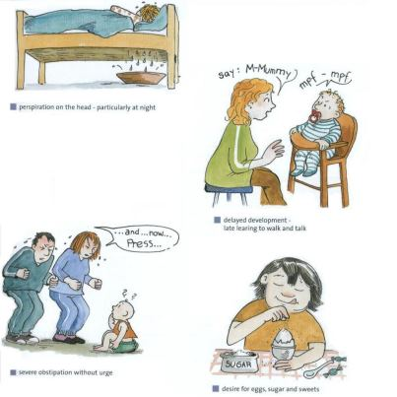

Slide 5
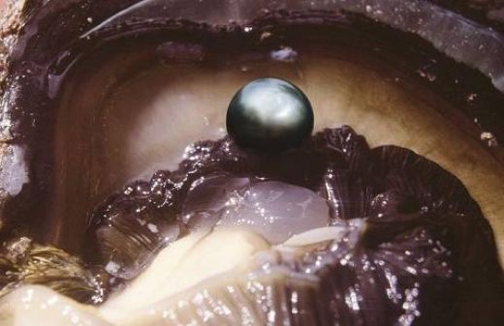
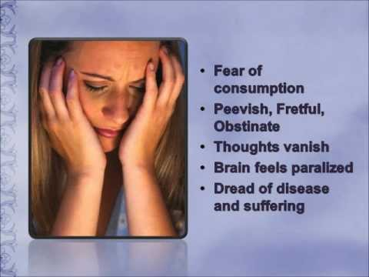

Slide 6
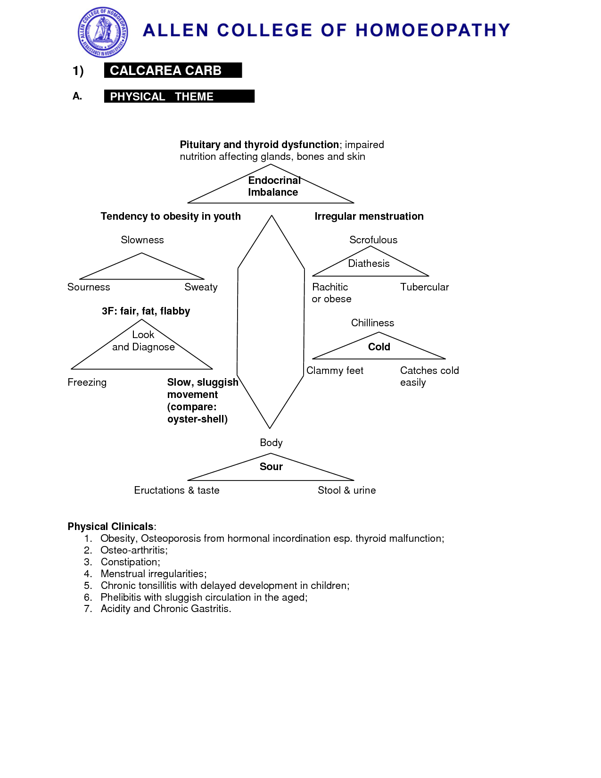

Slide 7
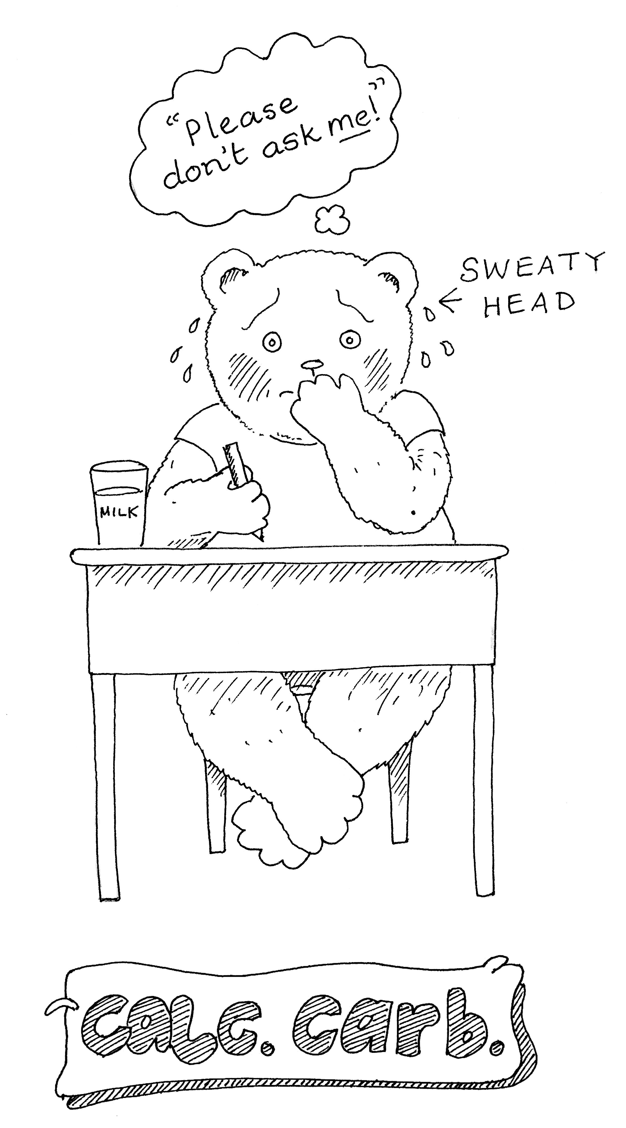

Slide 8
PREPARATION
For Hahnemann's provings, trituration of the middle layer of the oyster-shell.
For Dr. Koch's provings, precipitated carbonate of lime from a solution of chalk in hydrochloric acid, is triturated with an equal quantity of sugar of milk;twenty parts of this are mixed with one hundred parts of alcohol, and this is termed the tincture.

Slide 9
This great Hahnemannian anti-psoric is a constitutional remedy par excellence.
Moreover, Calcarea is one of the polychrest remedies, and ranks with Sulphur and Lycopodium at the head of the antipsorics.

Slide 10
All three have a very wide range and deep action.
They have many symptoms in common, but Calc. is somewhat sharply distinguished from Sulphur in that it is a chilly remedy, the patient seeking warmth, whilst the Sulphur patient is agg. by heat, and >> by cold.
Calc. has cold, clammy feet, "as if there were damp stockings on"; Sulphur has characteristically hot, sweaty feet.
The "sinking sensation" common to all three is most marked with Sulphur at 11 a.m. , with Lycopod. at 4 p.m. , with Calcarea at any time

Slide 11
SOURCE
Milk and milk products are main source of calcium. Fish, vegetable, fruits, cereals (ragi rich in calcium) and drinking water are other sources.
(Green leafy vegetables are the cheapest natural source of calcium but the bio availability of calcium is poor.
Presence of oxalic acid, which forms an insoluble substance with calcium, namely calcium oxalate, which make the complete absorption of impossible.
Availability of calcium from a good source like milk is adversely affected by the simultaneous consumption of green leafy vegetable)
Recommended in take of calcium (adult) – 400 –500 mg / day.

Slide 12
CLARKE SAYS,
"Calcarea is one of the greatest monuments to Dr. Hahnemann's genius.
The triad of remedies, viz., Sulphur, Calcarea and Lycopodium can be called Hahnemann's magnificient gifts to humanity.
The excellent remedies - Sulphur, the predominant antipsoric, Calc-c, the excellent antisycotic and Lyc., the marvellous anti-syphilitic."

Slide 14
SPHERES OF ACTION
Through the great vegetative nervous system, Calcarea has five special centers of action:
OSSEOUS SYSTEM. Non-Ossification, Rachitis, and Caries.
LYMPHATIC GLANDULAR SYSTEM. Atony and Hypertrophy.
SKIN. Pale, Atonic, Flabby; Copious Perspiration.
MUCOUS MEMBRANES. Catarrhal Mucorrhoea.
BLOOD. Hydraemia; Anaemia; Water Increased.

Slide 15
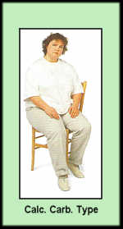
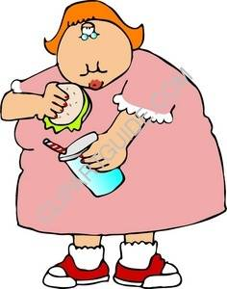
CONSTITUTION
Adapted to “leucophlegmatic” constitution
It is suited to FAIR, FATTY, FLABBY patient who is easily fatigued & tired on walking with much sweating , cold extrimities, sour smell of the body.
THERE IS TENDENCY TO OBESITY IN YOUTH.
Girls are fleshy, plethoric &grow too rapidly .

Slide 16
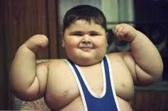
Suited to
Fat person with lax fiber .
Fat children who are slow in movement, of irregular growth with enlarged and hard lymphatic glands

Slide 17
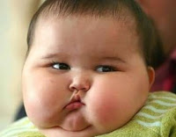
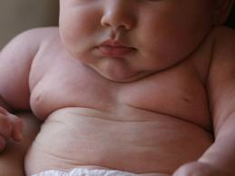
CHILDREN
who grow fat ,
chalky look with red face,
large belly like an inverted saucer
with LARGE HEAD, OPEN FONTANELLES & SUTURES
flabby muscles,
pale skin,
soft bones,
who sweat easily, specially on back side of the head & neck
swollen glands

Slide 18
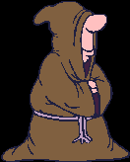
THERMALS
CHILLY PATIENT,DISPOSED TO CATCH COLD VERY EASILY
DIATHESIS
Scrofulous, rachitic & tubercular diathesis lymphatic,

Slide 20
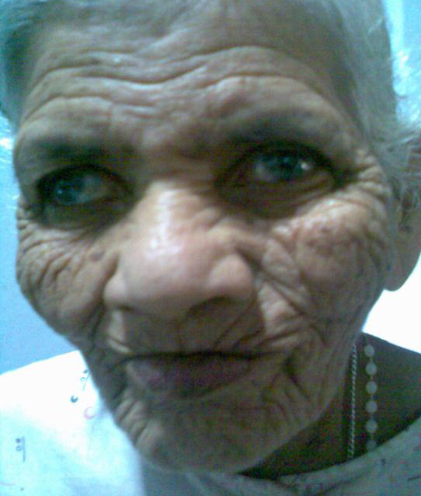
There is another type of appearance which can occasionally be seen;
a lean, thin, person with a lean face covered by fine wrinkles.
The fine wrinkles are arranged in horizontal and vertical lines producing small squares;
the overall appearance is of a person who has suffered a great deal.
This lean type of Calc. carb. patient undergoes all the typical stages of Calcarea pathology, even though his or her appearance does not resemble the classic stereotype.

Slide 21
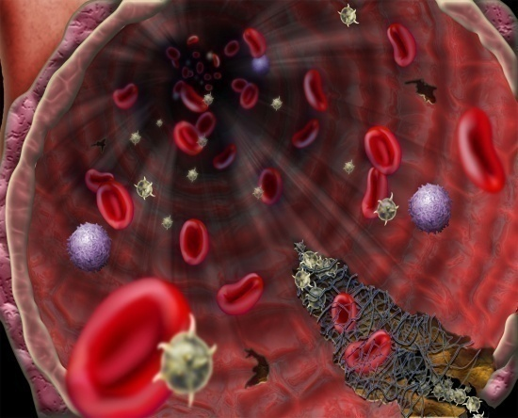
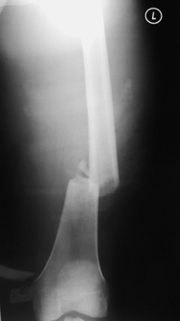
Calcium needed by the body for
The formation and maintenance of bone and teeth,
Coagulation of blood,
Regulation of neuromuscular irritability
Muscular contractility

Slide 22
Miasm
psora and syphilitic are predominant.
Posra -- Calc carb, Calc acet, Calc flour, Calc pho and Calc sul
Syphilitic—Calc flour, Calc iod Sycotic – Calc carb

Slide 24
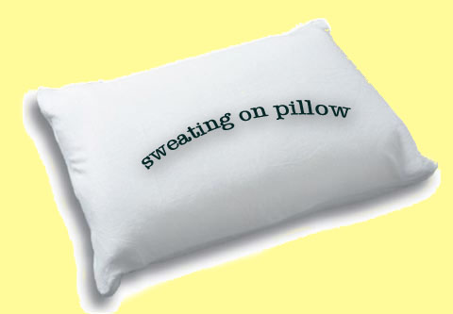

Slide 28
Mind
He is full of fear.
Weary of life; hopelessness, anxiety.
The world is black.
"Fear that something sad or terrible will happen.
Fears that she will lose her reason, or that people will observe her confusion of mind."
"Fear of death; of consumption; of contagious disease, of misfortune; of being alone.“
Apprehensive; worse towards evening;
Fear anxiety, and vertigo.
If his emotions stir him up he becomes dizzy.
From going upstairs the blood mounts to the head, and he becomes dizzy.
Confusion of mind and vertigo from mental exertion.

Slide 29
Mentally they are sad, depressed and melancholic with great anxiety
Anxiety with palpitation
Mental effort produces hot head
Averse to work

Slide 30
From Kent’s lectures
All the mind symptoms represent Calcarea as in a state of great weakness; inability to prolong mental operation.
He is tired mentally, and physically, from mental work and breaks down in a sweat, and becomes excited and irritable and disturbed.
Great disturbance of the emotions;
It is very useful in complaints from prolonged worry, from prolonged application to business,
from excitement.

Slide 31
HEAD
Vertigo on ascending and on turning head
Headache from overlifting , from mental exertion, with nausea
Head feels hot and heavy with pale face
Icycoldness in and on the head esp right side
Perspiration wets the pillow

Slide 32
EYES
Sports and ulcers on cornea
Dimness of vision as if looking through a mist
Chronic dilatation off pupil
Far sighted, cataract

Slide 33
EARS
Deafness from working in water
Srofulous inflammation with mucopurulent otorrhoea and enlarged glands

Slide 34
NOSE
Nostrils dry, sore, ulcerated
Polypi,swelling at the root of nose
Takes cold at every change of wether
Catarrhal symptoms with hunger,
Coryza alternates with colic

Slide 35
Face
- Pale, with deep-seated eyes, surrounded by dark rings.
Swelling of upper lip.
- Crusta lactea; itching, burning after washing.
- Submaxillary glands swollen.
- Goitre.
- Itching of pimples in whiskers.
- Pain from right mental foramen along lower jaw to ear.

Slide 36
Mouth
Persistent sour taste.
- Mouth fills with sour water.
- Dryness of tongue at night.
- Bleeding of gums.
- Difficult and delayed dentition.
- Teeth ache; excited by current of air, anything cold or hot.
- Offensive smell from mouth.
- Burning pain at tip of tongue; worse, anything warm taken into stomach.

Slide 37
Throat
- Swelling of tonsils and submaxillary glands; stitches on swallowing.
- Hawking-up of mucus.
- Difficult swallowing.
- Goitre.
- Parotid fistula.

Slide 39
Stomach
Aversion to meat, boiled things; craving for indigestible things - chalk, coal, pencils; also for eggs, salt and sweets.
Milk disagrees.
Frequent sour eructations; sour vomiting.
Dislike of fat.
Loss of appetite when overworked.
Heartburn and loud belching.
Cramps in stomach; worse, pressure, cold water.
Ravenous hunger.
Swelling over pit of stomach, like a saucer turned bottom up.
Repugnance to hot food.
Pain in epigastric region to touch.
Thirst; longing for cold drinks.
Aggravation while eating.

Slide 40
Abdomen
Hyperchlorhydria [Phos.].
- Sensitive to slightest pressure.
- Liver region painful when stooping.
- Cutting in abdomen; swollen abdomen.
- Incarcerated flatulence.
- Inguinal and mesenteric glands swollen and painful.
- Cannot bear tight clothing around the waist.
- Distention with hardness.
- Gall-stone colic.
- Increase of fat in abdomen.
- Umbilical hernia.
- Trembling; weakness, as if sprained.
- Children are late in learning to walk.

Slide 41
Respiratory
- Tickling cough troublesome at night, dry and free expectoration in morning; cough when playing piano, or by eating.
- Persistent, irritating cough from arsenical wall paper. (Clarke.)
- Extreme dyspnoea.
- Painless hoarseness; worse in the morning.
- Expectoration only during the day; thick, yellow, sour mucus.
- Bloody expectoration; with sour sensation in chest.
- Suffocating spells; tightness, burning and soreness in chest; worse going upstairs or slightest ascent, must sit down.
- Sharp pains in chest from before backwards.
- Chest very sensitive to touch, percussion, or pressure.
- Longing for fresh air.
- Scanty, salty expectoration. [Lyc.]

Slide 45
Heart
- Palpitation at night and after eating.
- Palpitation with feeling of coldness, with restless ,oppression of chest; after suppressed eruption.

Slide 46
Back
- Pain as if sprained; can scarcely rise; from overlifting.
- Pain between shoulder-blades, impeding breathing.
- Rheumatism in lumbar region; weakness in small of back.
- Curvature of dorsal vertebrae.
- Nape of neck stiff and rigid.
- Renal colic.

Slide 47
Extremities
- Rheumatoid pains, as after exposure to wet.
- Sharp sticking, as if parts were wrenched or sprained.
- Cold, damp feet; feel as if damp stockings were worn.
- Cold knees cramps in calves.
- Sour foot-sweat.
- Weakness of extremities.
- Swelling of joints, especially knee.
- Burning of soles of feet.
- Sweat of hands.
- Arthritic nodosities.
- Soles of feet raw.
- Feet feel cold and dead at night.
- Old sprains.
- Tearing in muscles.

Slide 48
Sleep
- Ideas crowding in her mind prevent sleep.
- Horrid visions when opening eyes.
- Starts at every noise; fears that she will go crazy.
- Drowsy in early part of evening.
- Frequent waking at night.
- Same disagreeable idea always arouses from light slumber.
- Night terrors [Kali phos.] Dreams of the dead.

Slide 49
Fever
- Chill at 2 p.m. begins internally in stomach region. Fever with sweat.
- Pulse full and frequent.
- Chilliness and heat.
- Partial sweats.
- Night sweats, especially on head, neck and chest.
- Hectic fever.
- Heat at night during menstruation, with restless sleep.
- Sweat over head in children, so that pillow becomes wet.

Slide 50
Skin
- Unhealthy; readily ulcerating; flaccid.
- Small wounds do not heal readily.
- Glands swollen.
- Nettle rash; better in cold air.
- Warts on face and hands.
- Petechial eruptions.
- Chilblains.
- Boils.

Slide 51
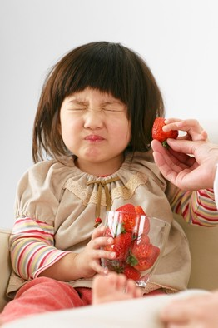
Desires and aversion
Desires: Alcoholic drinks
for beer, brandy, whisky and wine
Desires Ailments from alcoholic drinks
Complaints of drunkards after abstaining
Craving for alcohol
Cold drinks
Cold food aggravates her complaints:

Slide 52
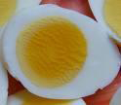
Important craving of calc
During either sickness or convalescence, great longing for eggs; craves indigestible things (Alum.); aversion to meat.
Longing for fresh air (when in a room) which inspires, benefits, strengthens (Puls., Sulph.).

Slide 53
All most all calcarea group medicines have a general weakness,
aggravation from motion or aversion to motion,
Amelioration by lying down
ailments from either mental or physical exertion.
All these features contributing to indolent, sluggish nature of the calcarea

Slide 54
pain
Almost all calcarea have stitching type of pain both internally and externally.

Slide 55
Dreams
Anxious ,Frightful ,Dead of Fantastic—coloured, Fire , Amorous dreams, With pollutions

Slide 56
hunger
Ravenous hunger with weak digestion Calc carb, Calc iod, Calc phos

Slide 57
Aversion
Meat
Milk agg
Calc group has a general aggravation from milk and aversion to milk

Slide 58
Almost all calcarea medicines are anaemic -Calc carb, Calc
Many of them are anticonvulsant

Slide 59
Convulsion
Convulsion after suppressed eruption
Convulsion after exertion
Convulsion from fear (fright from)
Convulsion with hydrocephalus

Slide 60
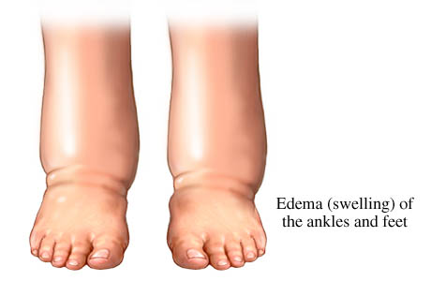
Dropsy – both external and internal
Almost all calcarea have emaciation and marasmus (Constitutionally they are fat and flabby)

Slide 61
Emaciation: Calc carb, Calc ars, Calc flour,
Ravenous appetite with emaciation
Emaciation of the affected parts: Calc carb Marasmus of the children

Slide 62
Tumors cystic Calc carb, Calc flour, Calc
Haemorrhagic tendency
Perspiration cold and profuse Profuse: Calc carb, Calc ars

Slide 63
sleep.
Sleeplessness Calcarea group has restless and disturbed sleep.
Frequent waking from sleep.
Sleep disturbed by fright, anxiety, dreams or thoughts.

Slide 64
stool
- Crawling and constriction in rectum.
- Stool large and hard [Bry.]; whitish, watery, sour.
- Prolapse ani, and burning, stinging haemorrhoids.
- Diarrhoea of undigested, food, fetid, with ravenous appetite.
- Children's diarrhoea.
- Constipation; stool at first hard, then pasty, then liquid.

Slide 65
Urine
- Dark, brown, sour, fetid, abundant, with white sediment, bloody.
- Irritable bladder.
- Enuresis. (Use 30th, also Tuberculin. 1m.)

Slide 66
Male
- Frequent emissions.
- Increased desire.
- Semen emitted too soon.
- Coition followed by weakness and irritability.

Slide 67
Menses
Menses too frequent, copious and protracted
- Before menses, headache, colic, chilliness and leucorrhoea.
- Cutting pains in uterus during menstruation.
- Menses too early, too profuse, too long, with vertigo, toothache and cold, damp feet; the least excitement causes their return.
- Uterus easily displaced.
- Leucorrhoea, milky [Sepia.].
- Burning and itching of parts before and after menstruation; in little girls.

Slide 68
Female
- Increased sexual desire; easy conception.
- Hot swelling breasts.
- Breasts tender and swollen before menses.
- Milk too abundant; disagreeable to child.
- Deficient lactation, with distended breasts in lymphatic women.
- Much sweat about external genitals.
- Sterility with copious menses.
- Uterine polypi.

Slide 71
Modalities
- Worse, from exertion, mental or physical; ascending; cold in every form; water, washing, moist air, wet weather; during full moon; standing.
- Better, dry climate and weather; lying on painful side.
- Sneezing (pain in head and nape).

Slide 72
aggravation
General aggravation at night and evening
Aggravation on ascending -Calc carb, Calc ars, Calc pho,
Aggravation after bathing

Slide 74
Relationship
- Antidotes : Camph.; Ipec.; Nit ac.; Nux.
- Complementary : Bell.; Rhus; Lycop.; Silica.
- Calcar. is useful after Sulphur where the pupils remain dilated.
- When Pulsatilla failed in school girls.
- Incompatible : Bry.; Sulphur should not be given after Calc.
- Compare : Aqua calcar.
- -Lime-water - (1/2 teaspoonful in milk); (as injection for oxyuris vermicularis), and Calc. caust.
- - slaked lime - (pain in back and heels, jaws and malar bones; also symptoms of influenza).
- Calc. brom. (removes inflammatory products from uterus; children of lax fiber, nervous and irritable, with gastric and cerebral irritation. Tendency to brain disease. Insomnia and cerebral congestion. Give 1x trituration).

Slide 75
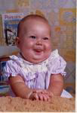

Slide 76
THANK YOU

